Slide 1
Social Engineering
aka People Hacking
White hat
Jaxon Haws
cpsec

Slide 2


About Me
2nd Year Computer Science
Clubs:
White Hat: Archivist -> President
CPLUG: Treasurer -> President
Finished my first racing season

Slide 3
Table of Contents
What is social engineering?
Why is social engineering effective?
Types of Social Engineering attacks
Where/when has social engineering been used?
How can you prevent social engineering attacks?

Slide 4
DISCLAIMER: Don't try any of this at home, work, public, etc without consent of individuals involved

Slide 5
What is social engineering?
We've been trying to reach you about your car's extended warranty...
Methods employed by hackers to gain the trust of an end user so that the hacker can obtain information that can be used to access data or systems.
Typically involves impersonating representatives of legitimate organizations to manipulate people into supplying sensitive information or access to restricted areas.

Slide 6
Types of Social Engineering Attacks
Digital interactions
Physical interactions

Slide 7
(Ph)-ishing
Phishing: a type of social engineering attack that uses email to entice a user to click on a malicious link from a legitimate appearing source.
When the user selects the ill-intentioned link, the user’s device or system becomes infected with malware and data is often compromised.
Spear Phishing/Whaling: a variation of phishing wherein a specific individual is targeted

Slide 8
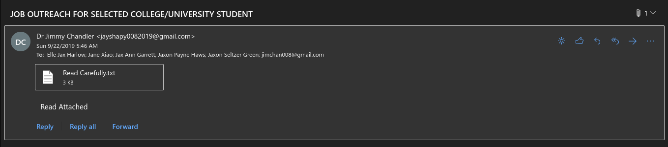
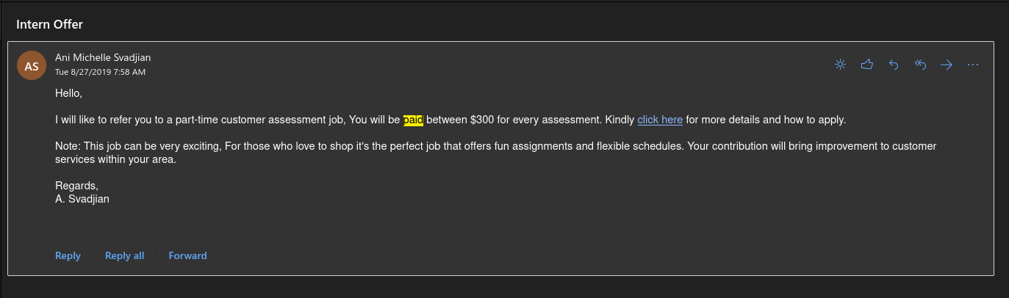

Slide 9
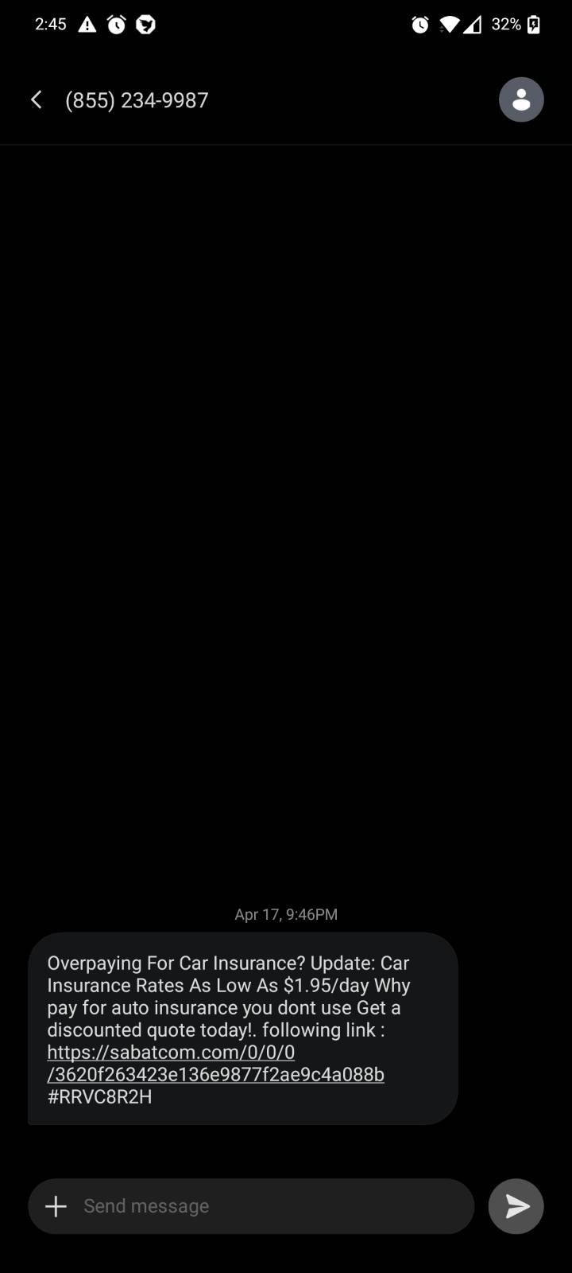
(SMs)-shing
Look out for suspicious links
Be wary of anyone who isn't in your contacts
Don't click the links

Slide 10
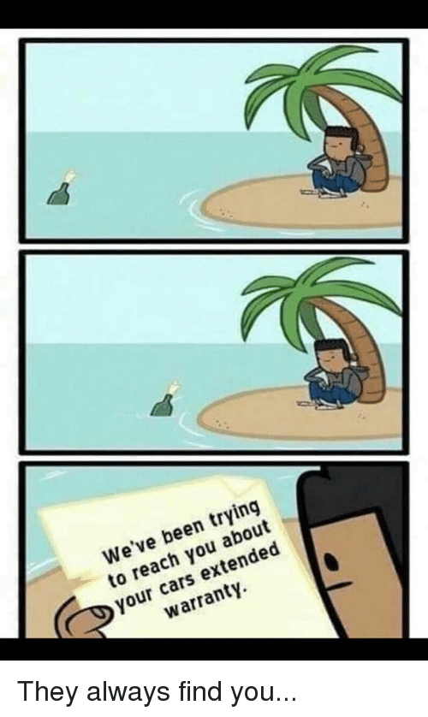
(Vi)-shing
Usually an automated voice system that calls you with an urgent problem that requires sensitive information
Spoofed phone number so you can't call back
Can be about: banking errors, social security number frozen, Windows has encountered problems, your warranty is about to expire, etc

Slide 11

Baiting
A social engineering attack where an attacker entices a user with a free item to lure them into clicking on a link.
This may come in the form of a free music or movie download lined up with the user’s interests.
Can also be in the form of a 'lost' USB drive that
gets unwittingly plugged into a machine to
spread malware.

Slide 12
Quid pro quo
Quid Pro Quo: “something for something” social engineering technique, the quid pro quo attack involves promising a service or benefit for complying with the request of an attacker.
For example, a social engineer may promise a free software upgrade to entice a user to download what is actually malware to their system

Slide 13
Pretexting
Pretexting: With pretexting, an individual impersonates a representative from a trusted organization with the goal of acquiring sensitive information.
This social engineering technique relies heavily on gathering research before initiating contact with the target.
For example, a network admin/ IT person coming to speed up the internet

Slide 14

Tailgating
Not the car kind
Tailgating: when a person gains access to restricted areas by following an approved employee into the area and piggybacking on their credentials.
This social engineering tactic is a physical attack.
In these cases, the social engineer often pretends to be an employee or even a delivery person.

Slide 15
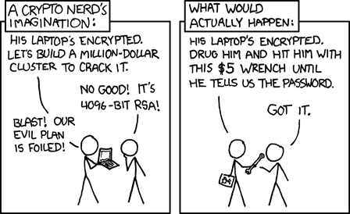
Why is Social Engineering Effective?
There's always a relevant xkcd

Slide 16
WHy does this work?
Fear
Greed
Curiosity
Helpfulness
Urgency

Slide 17

This hasn't actually happened in the real world right?
Spoiler alert: it has

Slide 18

High-Viz Vest
Wearing a high-viz vest gives off an impression of authority
Additional props such as radios, clipboards, lanyards, etc can increase authority
Walking through exits surprisingly works

Slide 19

2013 Target Data breach
In 2013, more than 110 million customers fell victim to a social engineering attack on Target.
Social engineering techniques were used on an HVAC company that had remote access to Target’s network.
The HVAC company was then compromised with malware, which in turn infected Target’s systems.
The attack resulted in the loss of emails, names, addresses, phone numbers and credit and debit card information.

Slide 20


Kane Gamble
A 15-year-old was able to take control of the secure emails of John Brennan, the director of the CIA.
Kane Gamble used social engineering to convince Verizon to provide personal details about Brennan, which he later used to impersonate the CIA director.
Gamble was able to access Brennan’s email by changing security questions and passwords with gathered intel, allowing the 15-year-old to view sensitive military information.

Slide 21
How can you prevent social engineering attacks?
Hot take: you can't

Slide 22

Preventing Digital social engineering attacks
Question everything
Don't click on suspicious links
Don't give out information over the phone if you didn't call them
Don't plug in random devices that you find

Slide 23

Preventing in person social engineering attacks
Question everyone
Don't let random people into restricted areas
Verify ID badges
Ask questions and don't turn a blind eye
In the workplace, conduct trainings

Slide 24
Questions?

Slide 25
Sources
https://www.comptia.org/content/articles/what-is-social-engineering
https://terranovasecurity.com/examples-of-social-engineering-attacks/
https://en.wikipedia.org/wiki/Social_engineering_%28security%29
https://youtu.be/dQw4w9WgXcQ
https://youtu.be/GyvRamX1VyA
https://youtu.be/tCRT3QFzwm8

